Slide 1
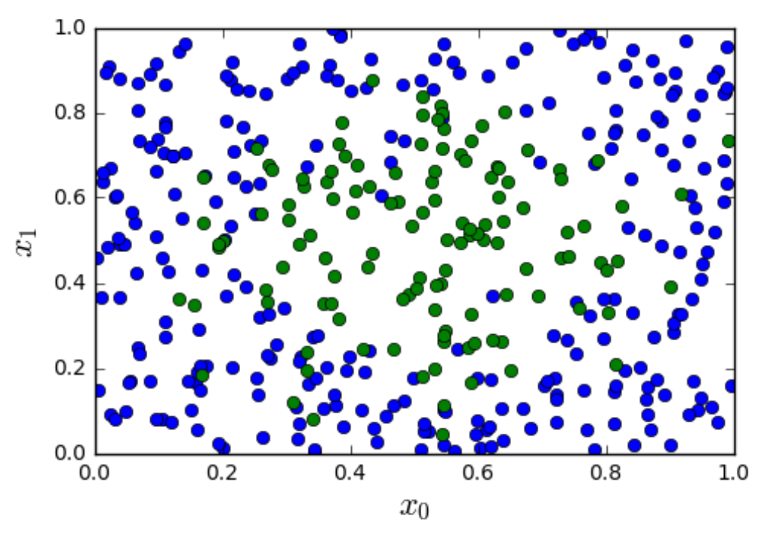
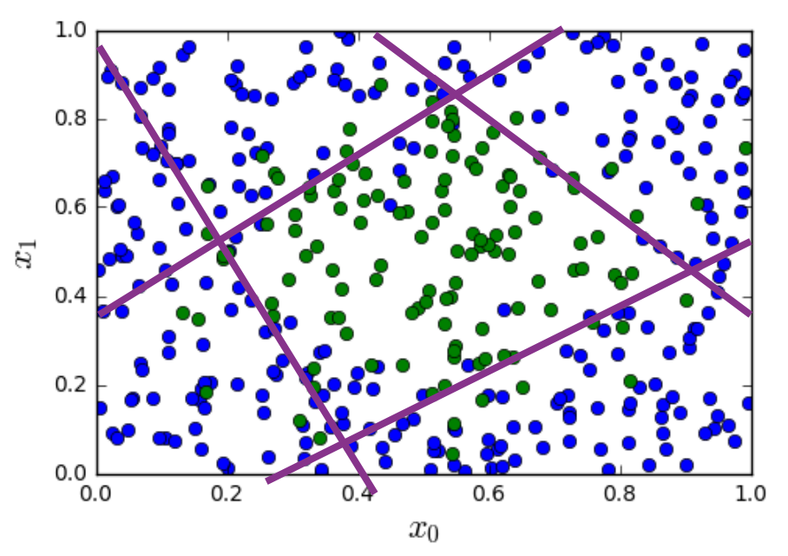

Slide 2
0
1
1
0
0
0
1
1

Slide 3
0
1
1
0
0
0
1
1

Slide 4
⟹
⟹

Slide 5
non-linearity/
activation function
linear map
non-linearity/
activation function
x₁
linear map
x₂
⟶
z_{O}
⟶
u_{O}
x₃
W_{O}u_{H}+ b_{O}
g(z_{O})
⟶
x
⟶
⟶
⟶
⟶
W_{H}x + b_{H}
z_{H}
⟶
u_{H}
g(z_{H})
output layer
hidden layer

Slide 6
sigmoid
non-linearity
linear map
sigmoid
non-linearity
x₁
linear map
x₂
⟶
z_{O}
⟶
u_{O}
x₃
W_{O}u_{H}+ b_{O}
g(z_{O})
⟶
x
⟶
⟶
⟶
⟶
W_{H}x + b_{H}
z_{H}
⟶
u_{H}
g(z_{H})
output layer
(standard linear classifier)
hidden layer (feature extraction)

Slide 8
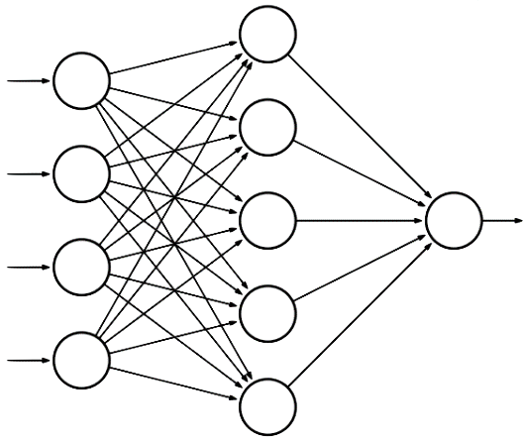
hidden layer
input layer
x₁
output layer
x₂
u_{O}
x₃
z_{O}
x₄
⟶
x
⟶
z_{H}

Slide 9
hidden layer
input layer
W_{H}[1,1]
x₁
W_{H}[1,2]
W_{O}[1,1]
output layer
x₂
W_{H}[1,3]
W_{O}[1,2]
W_{O}[1,3]
u_{O}
x₃
W_{O}[1,4]
z_{O}
W_{H}[1,4]
x₄
W_{O}[1,5]
⟶
x
⟶
z_{H}

Slide 10
hidden layer
input layer
x₁
W_{H}[2,1]
W_{O}[1,1]
W_{H}[2,2]
output layer
x₂
W_{O}[1,2]
W_{H}[2,3]
W_{O}[1,3]
u_{O}
x₃
W_{O}[1,4]
z_{O}
W_{H}[2,4]
x₄
W_{O}[1,5]
⟶
x
⟶
z_{H}

Slide 11
a
x
f = ax + by + cz
y
b
f
c
z
n₁
fire
n₂
∑
no fire
n₃

Slide 12
u₁
x₁
u₂
y
x₂
u₂
input
intermediate feature transform
final
feature transform
output

Slide 13
z₁
class 1
z₂
class 2
z₃
class 3
z₄
class 4
input layer
hidden layer
hidden layer
output layer

Slide 14
c
f
a
d
g
z
b
e
h
layer 0
layer 1
layer 2
layer 3

Slide 15
c
f
a
d
g
z
b
e
h
layer 0
layer 1
layer 2
layer 3

Slide 16
c
f
a
d
g
z
b
e
h
layer 0
layer 1
layer 2
layer 3

Slide 17
c
f
a
d
g
z
b
e
h
layer 0
layer 1
layer 2
layer 3

Slide 18
c
f
a
d
g
z
b
e
h
layer 0
layer 1
layer 2
layer 3

Slide 19
c
f
f
a
g
d
g
z
b
e
h
h
layer 0
layer 1
layer 2
layer 3

Slide 20
convex loss
cross-entropy loss for neural net

Slide 22
x
1
4
3
-1
2
-4
1
0
2
-1
w
1
2
1
x
1
4
3
-1
2
-4
1
0
2
-1
w
1
2
1
x
1
4
3
-1
2
-4
1
0
2
-1
w
1
2
1
x
1
4
3
-1
2
-4
1
0
2
-1
w
1
2
1
u

Slide 23
x
w₁
w₂
w₃

Slide 24
x
Uniform filter
(moving average)
Gaussian filter
u
u

Slide 26
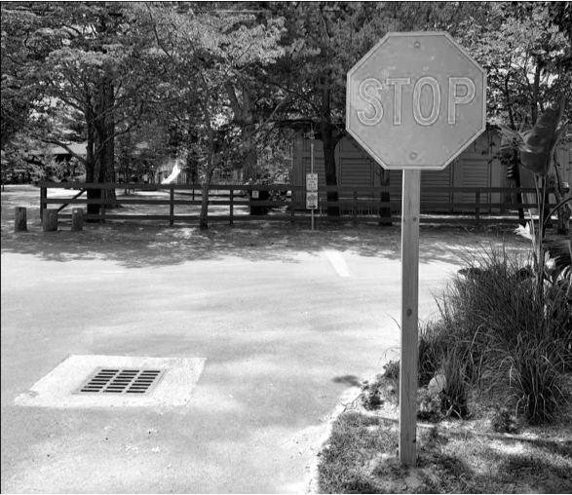
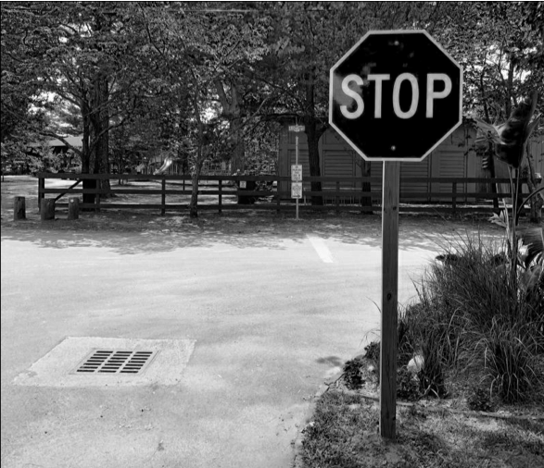
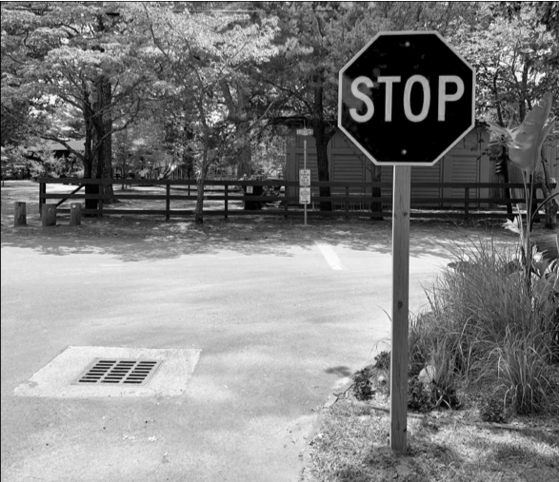
red channel
flatten
blue channel
green channel

Slide 27
w
x

Slide 28
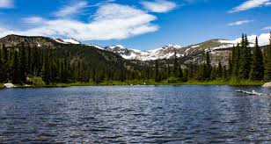
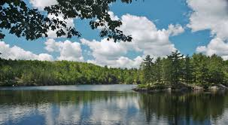



Slide 29
T
w
x
T
T
T

